Slide 1

DEPARTMENT OF COMPUTER SCIENCE & ENGINEERING
Predicting Poverty Level Using Image Sensing
Team members:
D. Hima Bindu -19NG1A0572
D. S. N. K. Suraj -19NG1A0571
CH. Bhanu Prakash Varma-19NG1A0569
T. Kusuma -19NG1A05B1

Slide 2
TABLE OF CONTENTS
Introduction
Abstract
Existing system
Disadvantages
Proposed system
Design architecture
System requirements
Programming languages and technologies
Algorithm model
Input & Output
Conclusion

Slide 3
INTRODUCTION:
The major objective is of Predicting poverty level using image sensing is to provide poverty level of certain area by analyzing its images using image sensing rather than conducting manual survey.
The goal of this research paper is to develop an application for predicting poverty level of an area via online. The system provides a platform where users can search the poverty level of their place and any other place. And this is also used to help the students who interested in economic survey.
The current challenge in this domain is that agencies across the world who predict income levels take a huge amount of time to do the same. Once done this topic is not raised until the next decennial census comes up.
Not only does it take a big chunk of time but also staggering amounts of money is invested into these kinds of projects. This is a real headache for agencies and governments all around the world.

Slide 4
ABSTRACT:
Determining the poverty levels of various regions throughout the world is crucial in identifying interventions for poverty reduction initiatives and directing resources fairly.
However, reliable data on global economic livelihoods is hard to come by, especially for areas in the developing world, hampering efforts to both deploy services and monitor/evaluate progress.
This project proposes to use satellite images to detect economic activity and, as a result, estimate poverty in a location. Here we use Image Sensing.
A Convolutional neural network is trained to learn various developmental parameters like rooftop type, source of lighting and proximity to water sources, Agriculture Areas, Road Structure and Industrial Areas.

Slide 5
EXISTING SYSTEM:
Currently, poverty is formally calculated by numerous philanthropic agencies including the World Bank.
One of the reasons why data on poverty is sparse in the developing world is because it is infrequently collected due to the high cost associated with on-the-ground surveys.
The same project had been developed using RNN(Recurrent neural network) model.

Slide 6
Disadvantages:
The current challenge in this domain is that agencies across the world who predict income levels take a huge amount of time to do the same.
Once done this topic is not raised until the next decennial census comes up.
Not only does it take a big chunk of time but also staggering amounts of money is invested into these kinds of projects.
This is a real headache for agencies and governments all around the world.
Suffered to detect and analysis of night light images
Accuracy of the RNN model is high only for day light processing

Slide 7
PROPOSED SYSTEM:
Recent advancements in deep learning present an exciting opportunity for application to poverty prediction.
More specifically, both daytime and nighttime satellite imagery of regions can be used to estimate poverty in certain regions
Deep learning has been a main factor behind recent breakthroughs in numerous computer vision tasks such as image classification, segmentation, and object detection.
In this project, we test the hypothesis that deep learning can leverage satellite imagery to reliably predict the poverty level of a region.
For each city, we obtain a daytime satellite image, a nighttime satellite image, and the city’s wealth index.
Then we the train Convolutional neural networks (CNNs) to predict a city’s wealth index, given a satellite image.

Slide 8
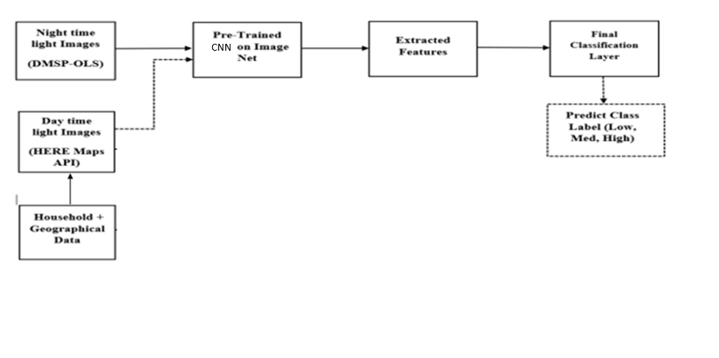
Design Architecture:

Slide 9
SYSTEM REQUIREMENTS
SOFTWARE REQUIREMENTS:
Front End – HTML, CSS, Flask
Backend – python 3.7.3
HARDWARE REQUIREMENTS:
Hard Disk: Greater than 500 GB
RAM: Greater than 4 GB
Processor: I3 and Above

Slide 10
TECHNOLOGIES:
Machine learning
Python packages
Deep learning
Image classification
Object detection

Slide 11
PROGRAMMING LANGUAGES AND PACKAGES:
Python
Numpy
Pandas
Matplotlib
Anaconda
OpenCV
Scikit-learn

Slide 12
ALGORITHM MODELS
Image Classification :
Image classification is the task of assigning a label or class to an entire image. Images are expected to have only one class for each image. Image classification models take an image as input and return a prediction about which class the image belongs to.
Image segmentation :
The process of splitting images into multiple layers, represented by a smart, pixel-wise mask is known as Image Segmentation
Object detection :
Object Detection is a computer technology related to computer vision, image processing, and deep learning that deals with detecting instances of objects in images and videos
Inception V3:
The Inception V3 is a deep learning model based on Convolutional Neural Networks, which is used for image classification. Inception v3 is an image recognition model that has been shown to attain greater than 68.1% accuracy on the ImageNet dataset. As the name suggests it was developed by a team at Google. It has higher efficiency.

Slide 13
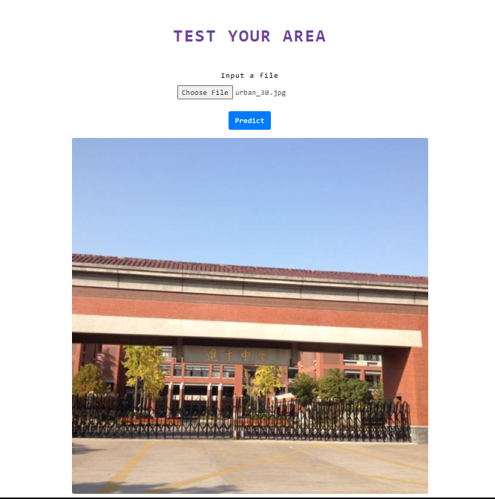
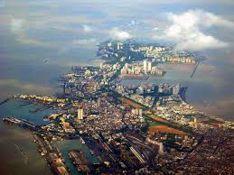
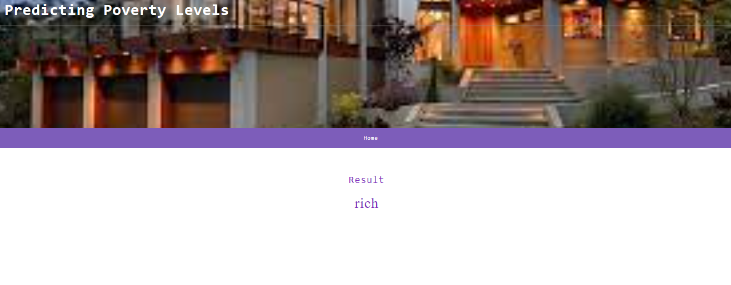
Input:
Output:

Slide 14
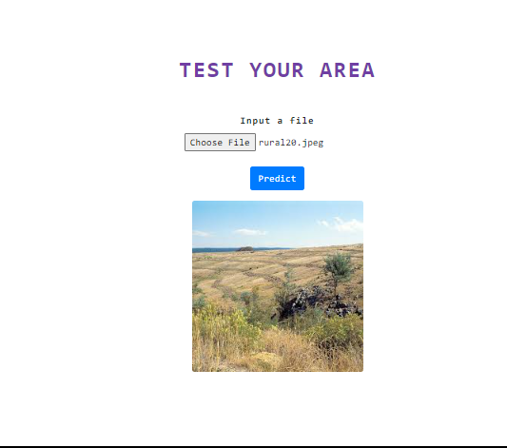
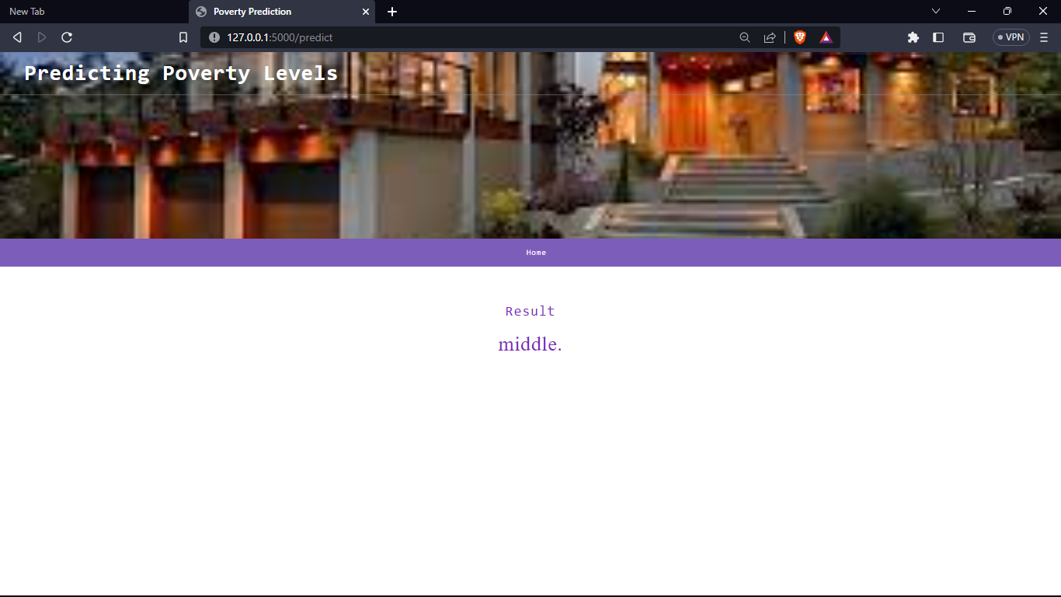
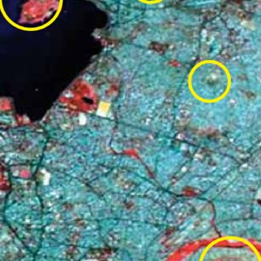
Input:
Output:

Slide 15
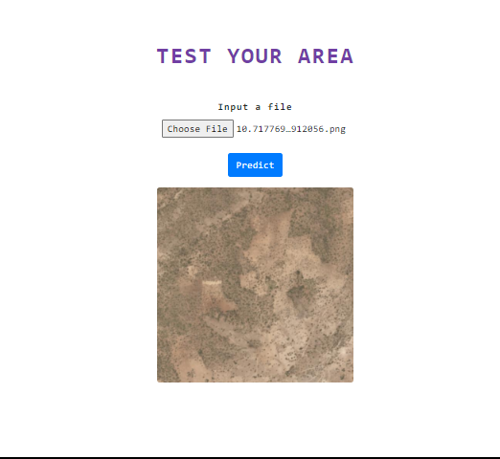

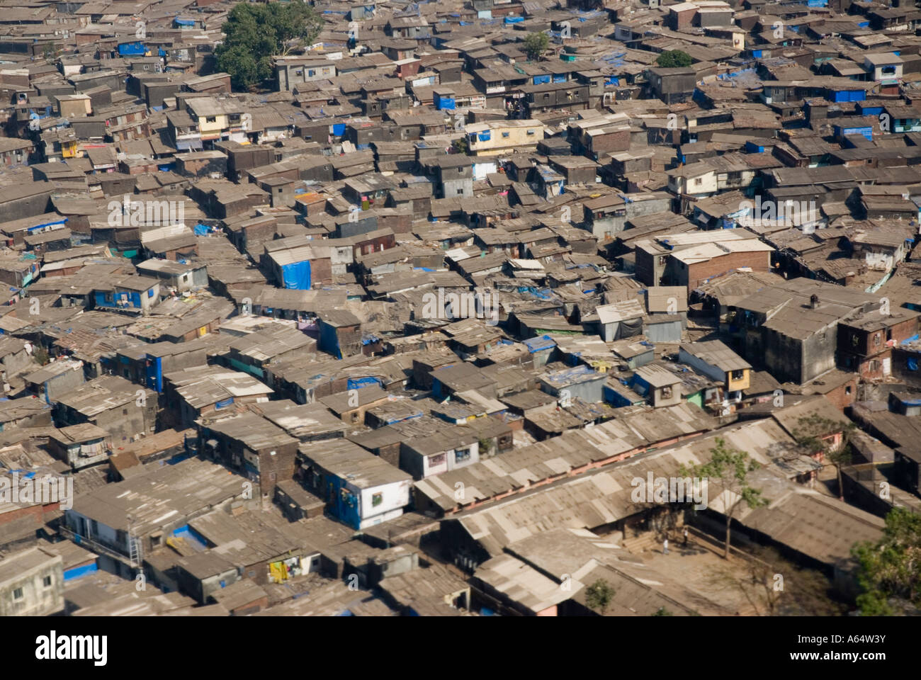
Input:
Output:

Slide 16
CONCLUSION:
Our idea is to predict the poverty index of a particular region in India. It is inspired by the successful use of deep learning approaches for poverty prediction in several African countries as appreciated in literature. With this paper, we want to estimate the correlation of poverty predicted from satellite images and wealth score obtained from DHS survey data of India. On successful implementation, the result obtained will be compared with the result obtained from ground-level surveys. Firstly, the model takes Demographic and Health Survey Data i.e., Household Data (dataset has record for each individual) and Geographical Data (Health Data, Infrastructure such as roads, buildings linked with DHS Data).

Slide 17
THANK YOU !

